Slide 1
EV Moghaddam
Terrell Blackgoat
Miwa Dawidowicz
Austin Engelbrecht
EV Moghaddam 11/3/21

Slide 2
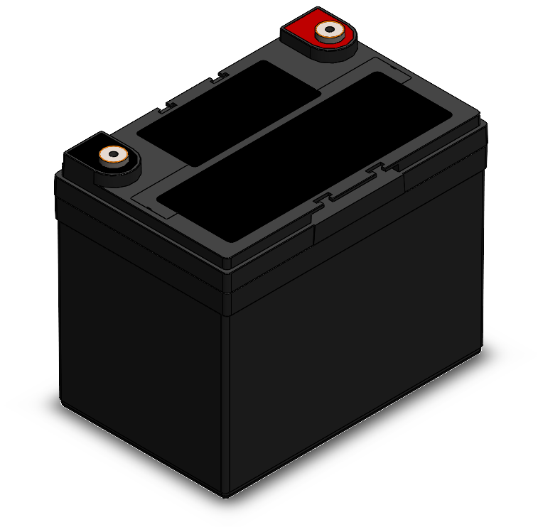
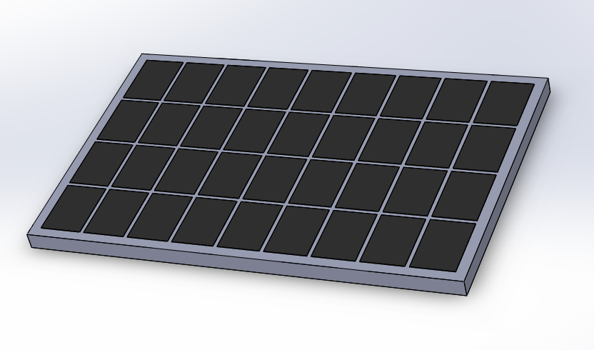
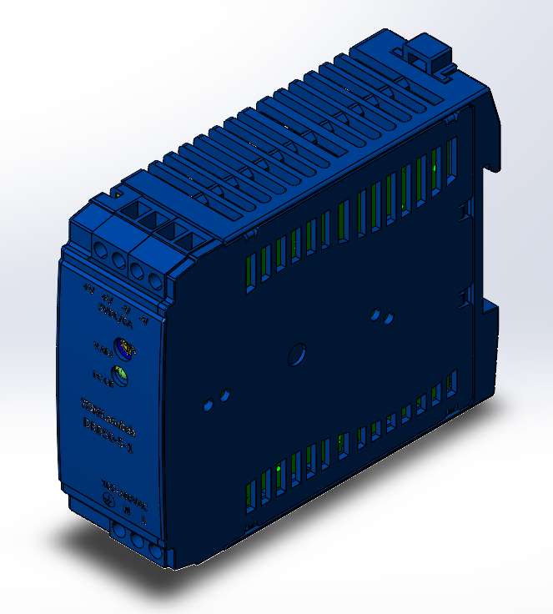
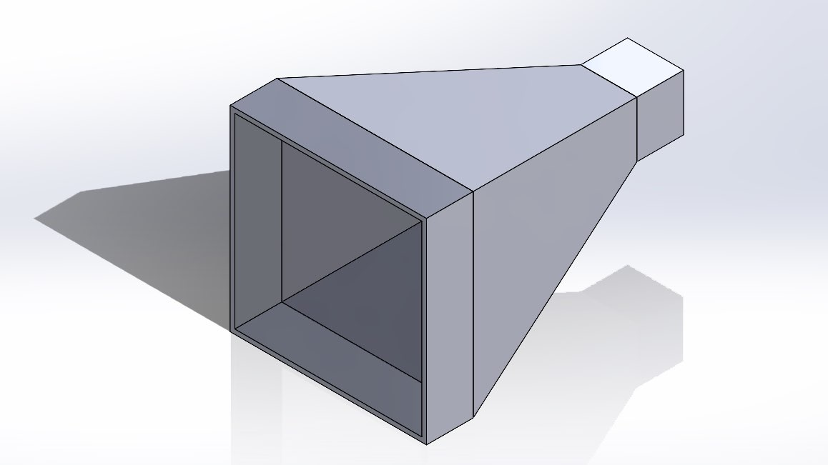
Prototype and CAD Package
Figure 4: Deep Cycle Battery
Figure 3: Solar Panel
Figure 1: Thermoelectric generator
Figure 2: DC-DC Converter
Figure 5: Diffuser
EV Moghaddam 11/3/21
Notes:
Create and bring either a low fidelity prototype of your compete proposed design or several prototypes of critical subsystems. The prototype CANNOT be entirely 3D printed.
Bring at least FIVE physical copies of your current state (draft) of the CAD package and Bill of Materials (BOM).
During the presentation, refer to the physical prototype that your team has created and the Bill of Materials. Prototype Comments:

Slide 3
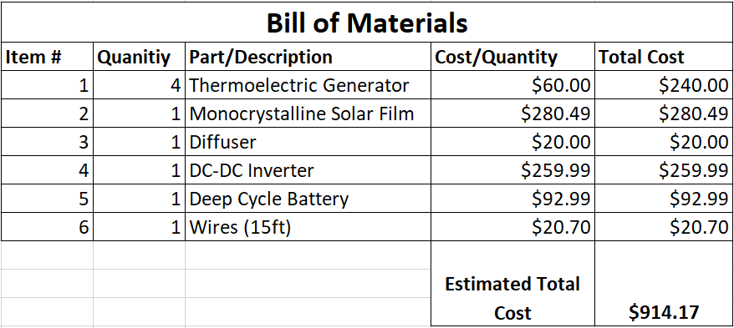
Prototype and CAD Package

Slide 4
Project Description
Sponsor:
Dr. Hesam Moghaddam
Task:
Design an add on system which will harvest energy from existing sources surrounding the vehicle and direct this energy gathered to an electrical component of the vehicle to be powered
Goal:
Increasing performance of an electric vehicle by reducing the amount of electrical energy needed to power various components of the vehicle
EV Moghaddam 11/3/21

Slide 5
Design Description
The most current rendition of the design: Solar panel, thermoelectric generators, diffuser generator combination, charge controller, deep cycle battery
All of this will go to power the headlights of the vehicle
This particular design was chosen to give the team the best chance of gathering electrical energy to direct toward powering a function of the vehicle while meeting all of the customer requirements
EV Moghaddam 11/3/21
Notes:
Describe current state of your design and CAD model
Provide high quality image of your design with subsystems labeled on the image.
Provide computational proof that the CRs and ERs have been satisfied. Discuss analytical analysis that have been conducted to prove the design will be successful.

Slide 6
Design Description
Energy gathered from brake heat, solar energy, and diffuser turning generator
Energy is transferred to a the DC-DC inverter
Energy is stored in a battery
Current flow is controlled by a charge controller
Energy is sent to the vehicle’s headlights
EV Moghaddam 11/3/21

Slide 7
Design Requirements (Customer Requirements)
Device should not add significant weight to the car
Device should not add significant cost to the overall car retail price (Max: $1000 if justified)
Device should harvest/generate enough electricity to perform a proper electrical function in the car such as supplying electricity for headlights, stereo, etc
Device should not compromise the aesthetics of the car
Device can be an add-on to the car so can be sold and installed separately
Design must be reliable enough to be used in market application
EV Moghaddam 11/3/21

Slide 8
Design Requirements
Teams design meets the requirements for price and weight since chosen components were lightweight and came below max cost
The device will generate enough electricity to power a function of the car with the data shown
Device being an add on an not ruining the vehicles aesthetics will be met by the choice of components being either hidden or not noticeable
Reliability of the device is ensured by the use of aftermarket products that have been proven reliable already
EV Moghaddam 11/3/21

Slide 9
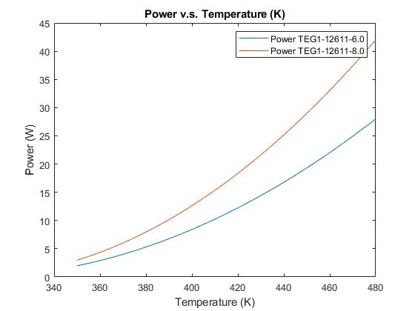
Design Requirements
Thermoelectric generators are shown to generate enough electricity to power most minor vehicle operations using an equation given in Ferrotec’s Thermoelectric Technical Reference text
Using this equation and plotting in matlab we were able to see power for multiple generator types
EV Moghaddam 11/3/21

Slide 10
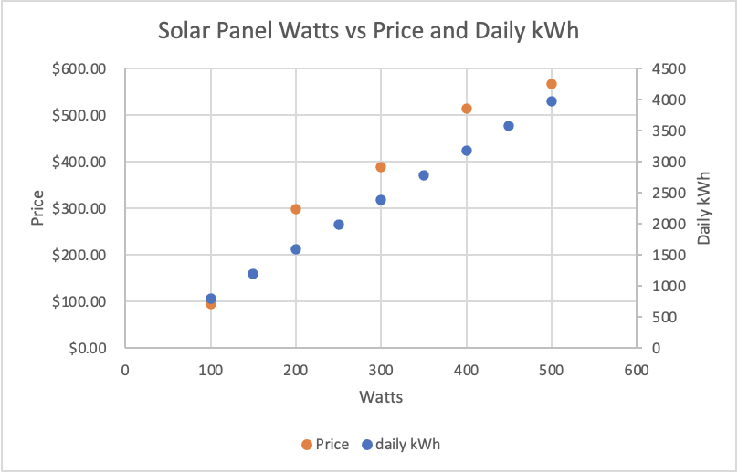
Design Requirements
Since solar panels convert sunlight into electricity, excess energy can be stored into batteries . Thus leaving solar panels the potential to power different components of the car.
In order to calculate the amount of energy that would be gathered by the monocrystalline solar panel, we used this equation to estimate the electricity output that would be generated by the solar panels:
Average hours of sunlight * Solar panel watts * Performance Ratio (~75%) = daily watt hours [2]
(10.6 hours)*(175 Watt)*(0.75) = 1,391 daily watt-hours
EV Moghaddam 11/3/21

Slide 11
Design Validation
Testing Procedures that we will complete in second semester:
Using computer software and physical devices to test the design’s components including the solar panel, diffuser, and thermoelectric generator
Also testing the storage components and their ability to be used in real scenarios
The equipment needed to complete the Testing Procedures include:
Multimeter to measure current and voltage
Computer software to provide basis of data
Battery tester
All of the components of the design in order to test their effectiveness
EV Moghaddam 11/3/21
Notes:
• Discuss your team’s FMEA, including critical potential failures and how your design mitigated these potential failures. Discuss the risk trade-off analysis that your team has performed.
• Provide an overview of the Testing Procedures that you will complete in the second semester to prove the ERs have been met.
• List all equipment, resources, space, etc. needed to complete the Testing Procedures.

Slide 12
Design Validation
Table 1: EV Moghaddam FMEA

Slide 13
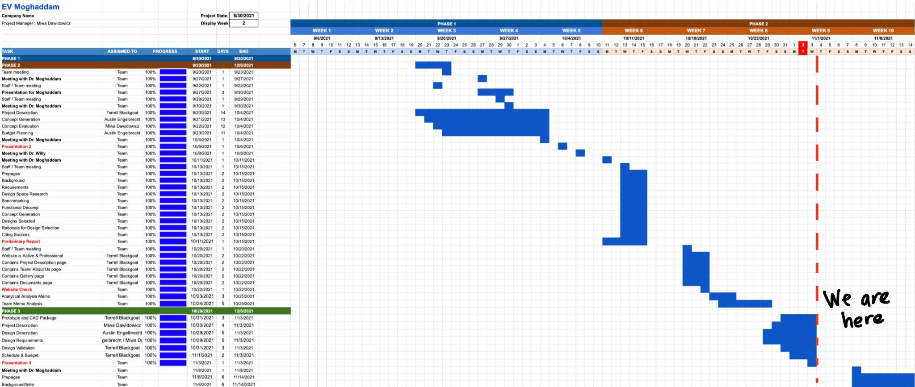
Semester 1 Current Project Timeline
EV Moghaddam 11/3/21

Slide 14
Schedule and Budget
This Semester:
Manufacturing Diffuser
Prototyping different diffuser designs.
Prototype testing
Gather data from Diffuser/ TEG/ Solar panel to analyze design concept.
Next Semester:
Manufacturing Diffuser
Prototyping
Design Testing
Prototype testing
Ensure viability of design
Budget
Current budget allowance
$1500
Most of the current prototyping was made out of materials that were already on hand.
~ $ 980 estimated purchasing budget
3D printing diffuser
Purchasing TEG and film solar panels.
EV Moghaddam 11/3/21
Notes:
Provide a schedule for the next term showing when key tasks will be completed. Indicate if you are currently on, ahead, or behind schedule. Discuss how the team broke down the work for each person. The schedule must include more deadlines than what the class provides in the overall course schedule (break up all deliverables into manageable tasks).
Describe the project’s budget including total dollars available, anticipated expenses, actual expenses to date, and the resulting balance.

Slide 15
Questions?

Slide 16
References
[1] - https://thermal.ferrotec.com/technology/thermoelectric-reference-guide/thermalref13/
[2] - https://www.dynamicslr.com/a-guide-on-how-to-calculate-solar-panels-output/

